Slide 1
MBLC Intro to E-rate
Massachusetts Board of Library Commissioners
September 19, 2023

Slide 2
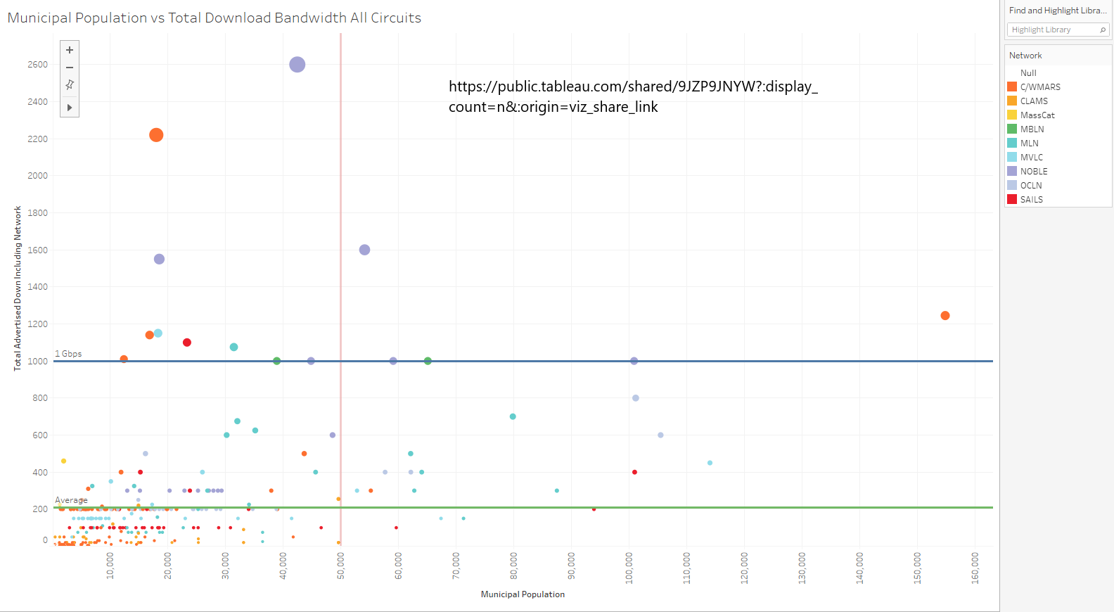

Slide 3
Quick E-rate Program Overview

Slide 4
E-rate Program Overview: Origin
Universal service program for schools and libraries
Part of Telecommunications Act of 1996
Discount Program
Application-based, NOT grant-based
Currently in its 27th year
Funding level historically was capped annually at $2.25 billion; now capped at $4.7 billion with annual inflation factor
Demand is below cap for recent years – funding is yours if you apply correctly
Notes:
The cap has never been reached for Priority 1 services
More room for typical library service growth
Rollover provides for even greater opportunities.

Slide 5
E-rate Program Overview: Discounts
Discount for libraries range from 20%- 90% on eligible services
Discount for libraries is based on:
NSLP eligibility for the school district in which main branch is located and
Urban/rural status determined by majority of library outlets (must be 51%+ to be considered rural)

Slide 6
E-rate Program Overview: Who is Eligible?
Schools and libraries are eligible
Library eligibility keyed to definition of library in and eligibility for LSTA
Must be budgetarily independent of educational institutions
Public school libraries eligible as part of school
Libraries tied to higher education not eligible
Must be not for profit (for-profit libraries are not eligible)

Slide 7
E-rate Program Overview: What is Eligible?
Program covers two categories of eligible services:
Category 1: Data Transmission and Internet Access
No limits on the speeds eligible
CIPA applies to Internet Access but not Data Transmission
Category 2: Internal Connections, Basic Maintenance, and Managed Internal Broadband Services
Internal connections includes network equipment and wiring – routers, switches, wi-fi, firewalls, racks, licenses, etc.
Basic Maintenance includes maintenance and support for these items
Managed Internal Broadband Services (MIBS) includes remote or web-based management of network infrastructure (e.g. managed wi-fi)
CIPA applies to all C2 services

Slide 8
E-rate Program Overview: What is Eligible?
Category 2 is limited by a five year pre-discount budget
Every library generally gets $4.50 per square foot or $25,000 per library outlet
Falmouth Public Library: $205,000
Nevins Memorial Library: $180,000
Bushnell-Sage Public Library: $45,000

Slide 9
E-rate Program Overview: Challenges
E-rate is not without challenges – but these challenges can be overcome!
Challenge #1: Administrative and Application Complexity
Procurement
Multistep Application Process
Documentation
Challenge #2: CIPA
Requires compliance for Internet Access and all Category 2 services
Requires a filter, Internet Safety Policy, and public meeting
MBLC is providing training and support over the next two years to help MA libraries overcome these challenges

Slide 10
MBLC E-rate Support for MA Libraries

Slide 11
MBLC E-rate Support
Consultant hired to provide help for interested libraries
Multiple live, virtual trainings for MA libraries starting this Fall
Will cover the entire application process, detailed information on filing forms, conducting E-rate compliant procurement, evaluating bids, awarding contracts, filing invoices, etc.
Will provide strong platform for those interested in applying
Mailing list for support from E-rate consultant
Sign up at https://mblc.state.ma.us/sympa/info/e-rate
Support for at least the next two years
There’s still plenty of time to start working on your E-rate Fund Year 2024 (7/1/2024-6/30/2025) application!

